Slide 1
Web scraping
Hiphop on Politics: Relationship between references of presidents in rap music and black lives broken down by NLP

Slide 2
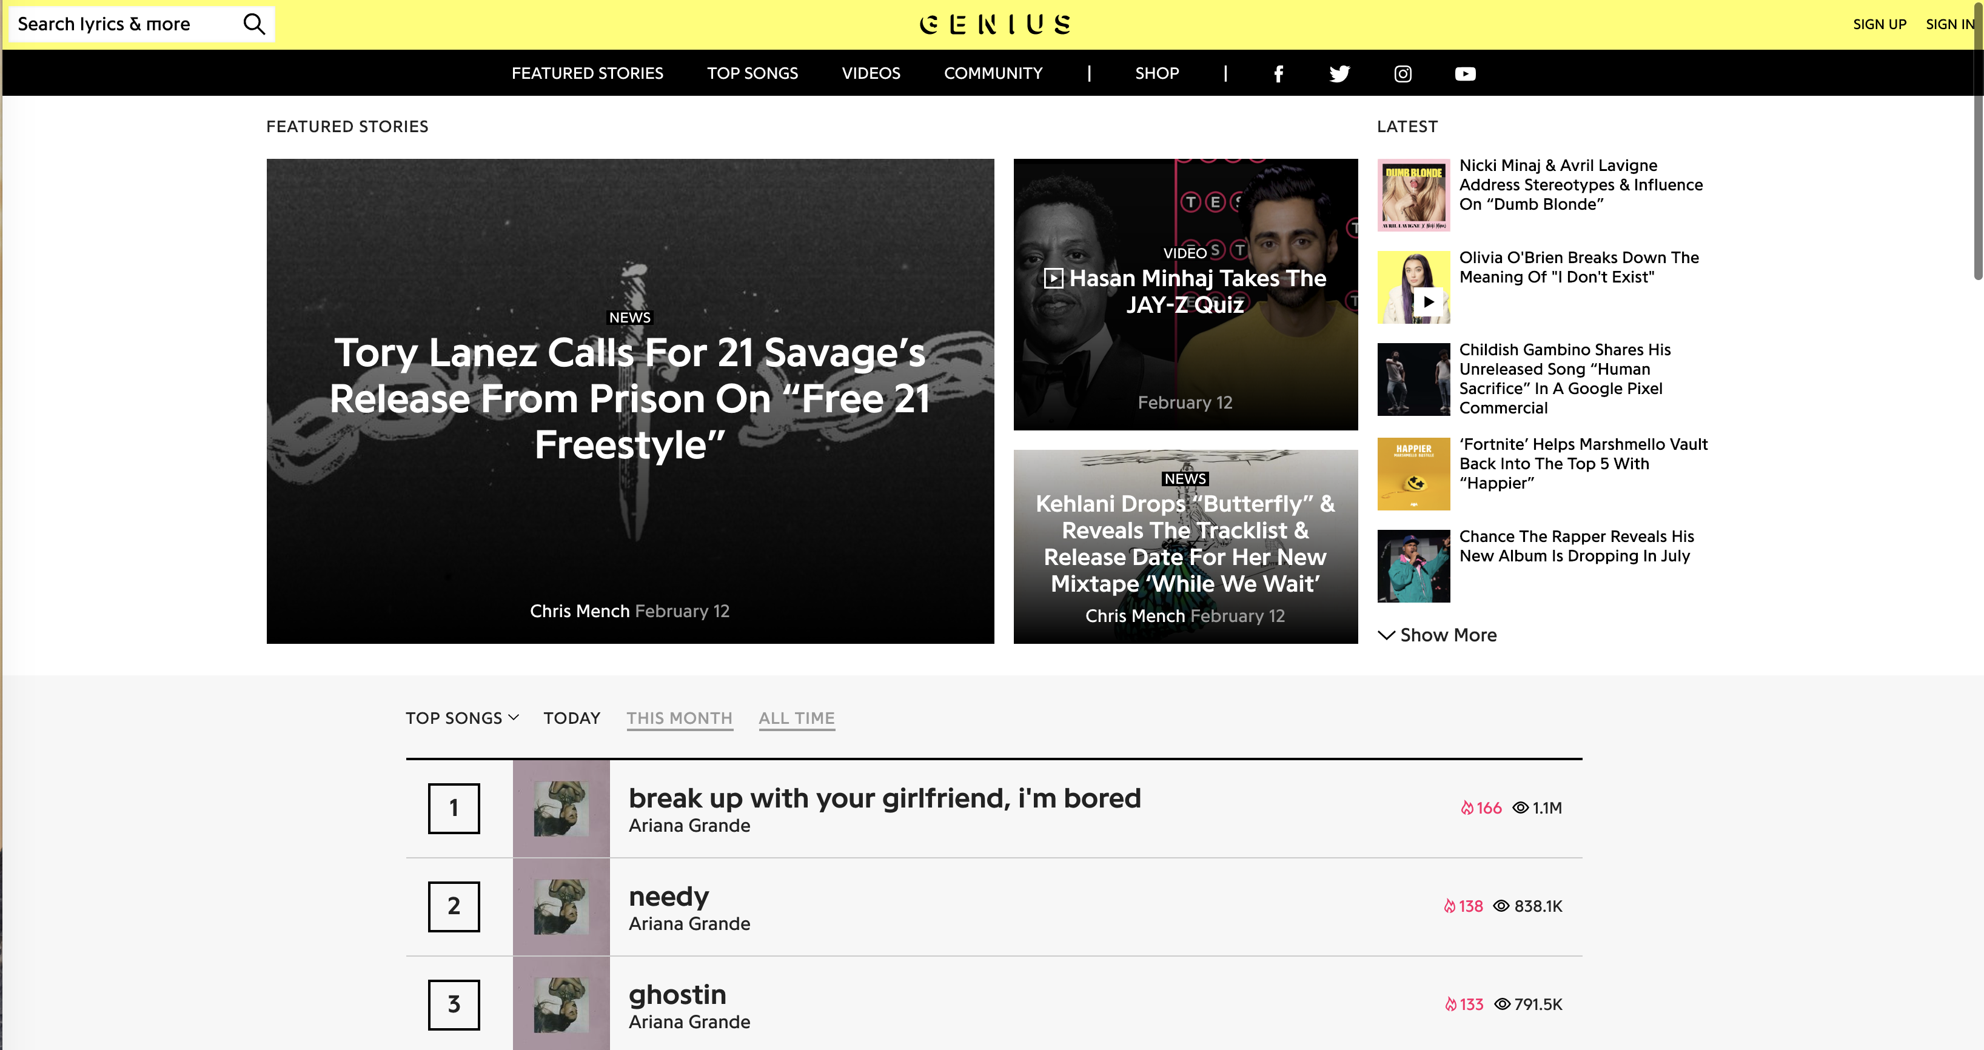
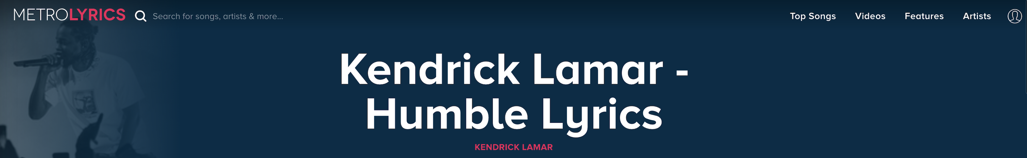
Website: Genius/Metro Lyrics

Slide 3
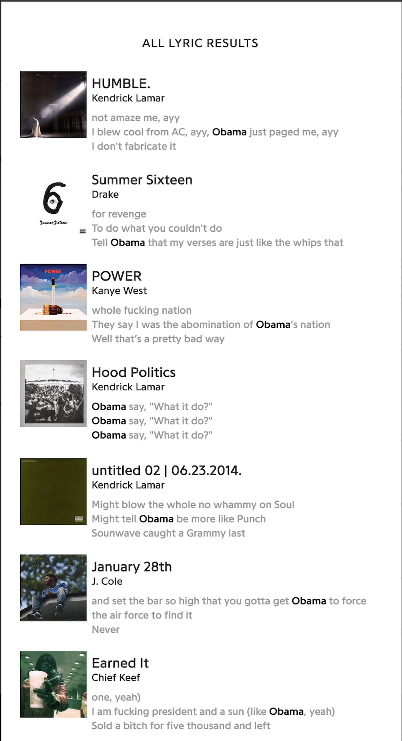
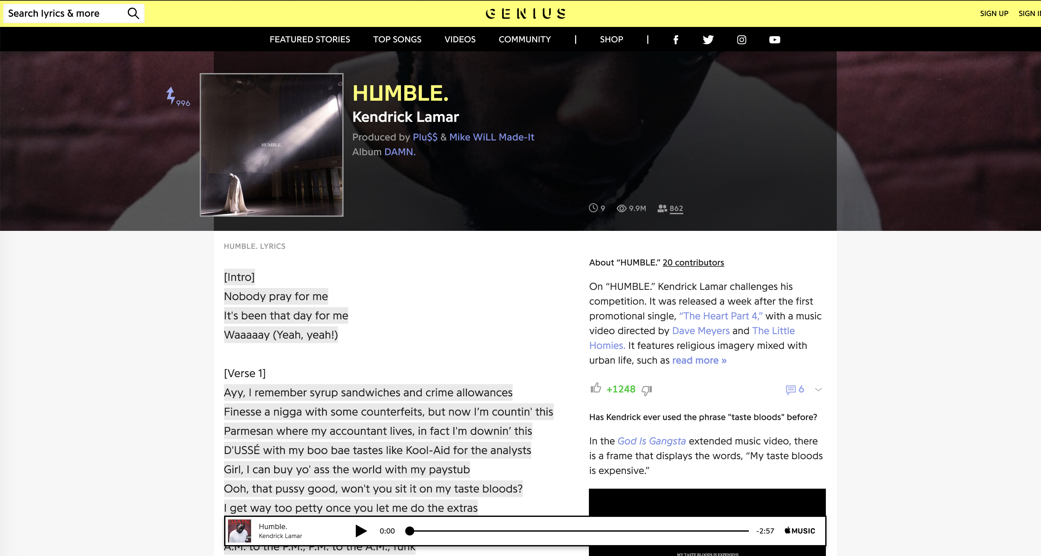
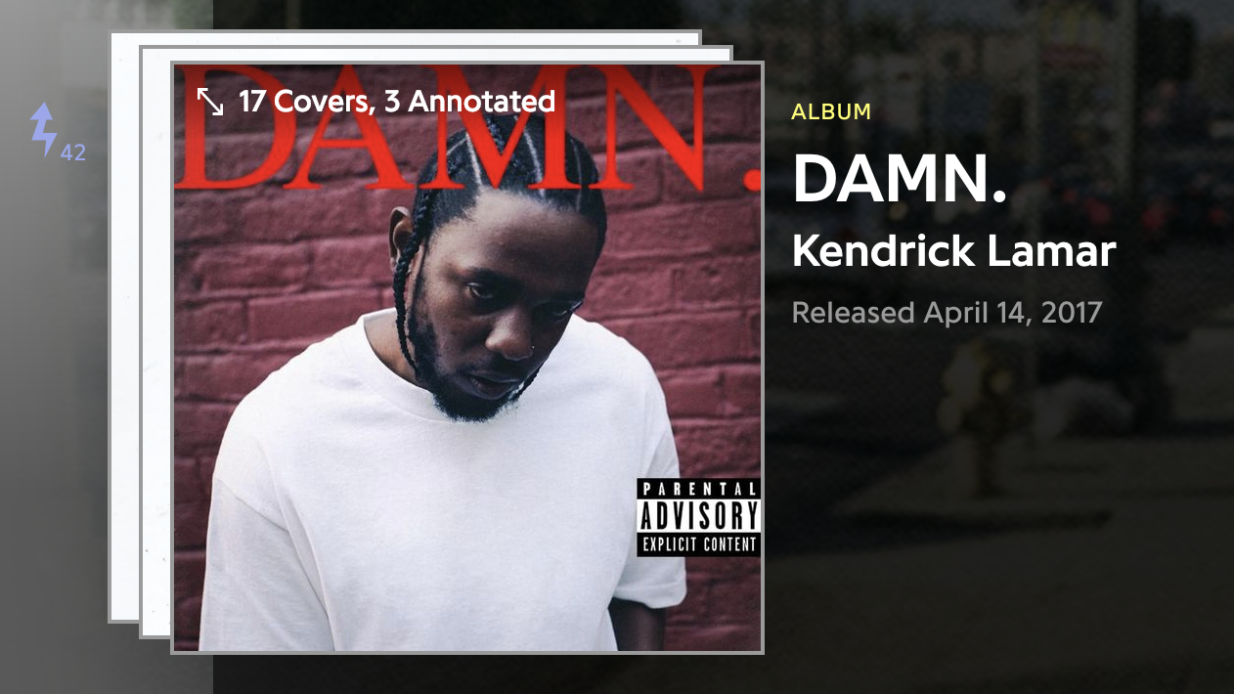
Selenium/Scrapy

Slide 4
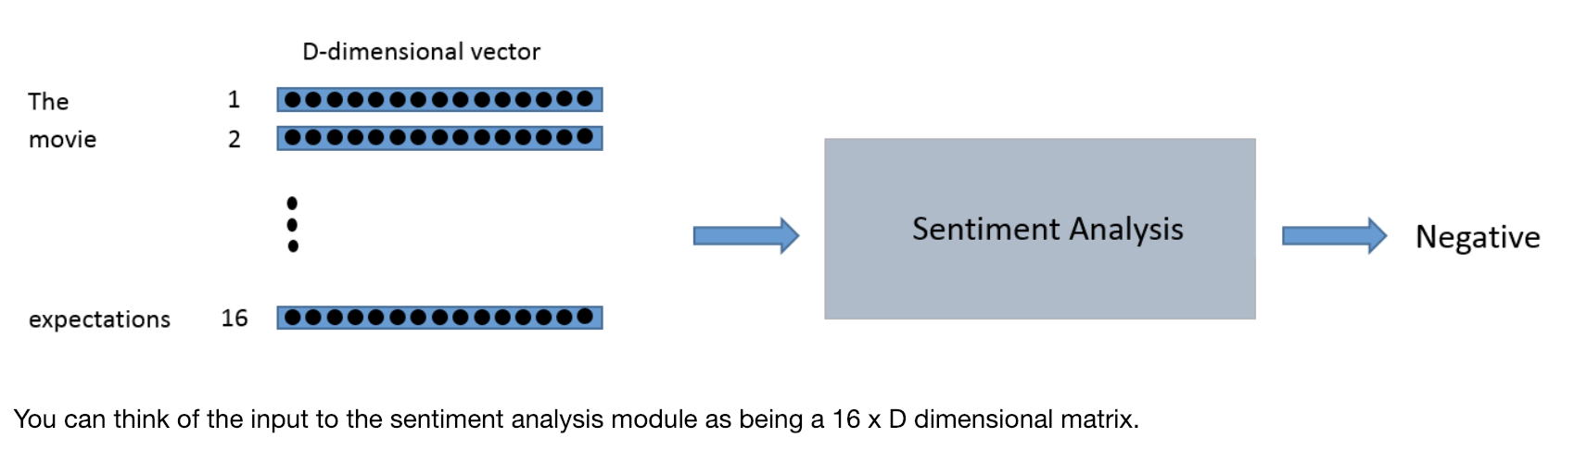
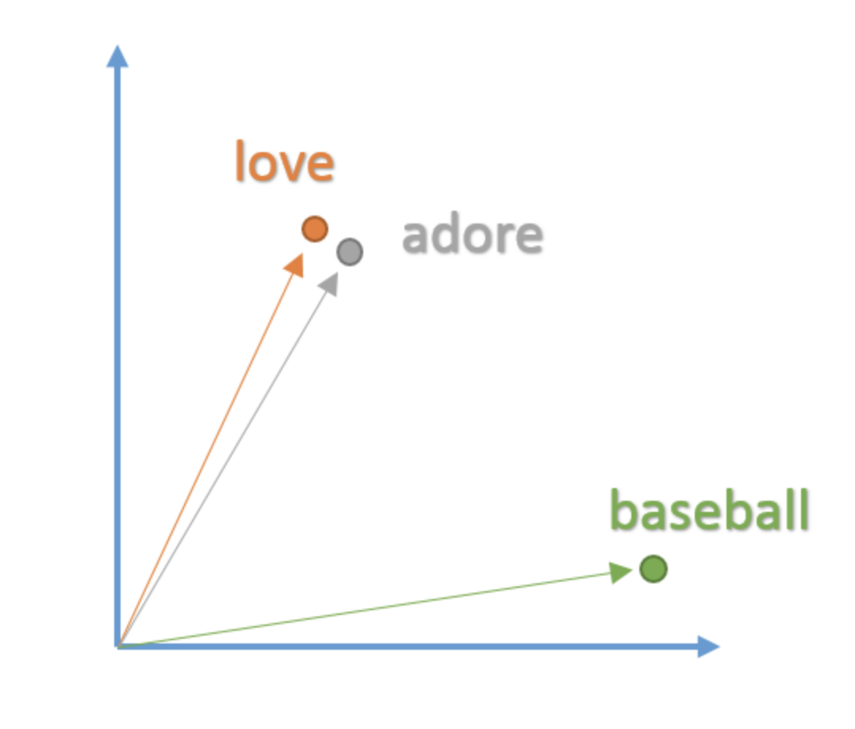
NLP…tenserflow

Slide 5
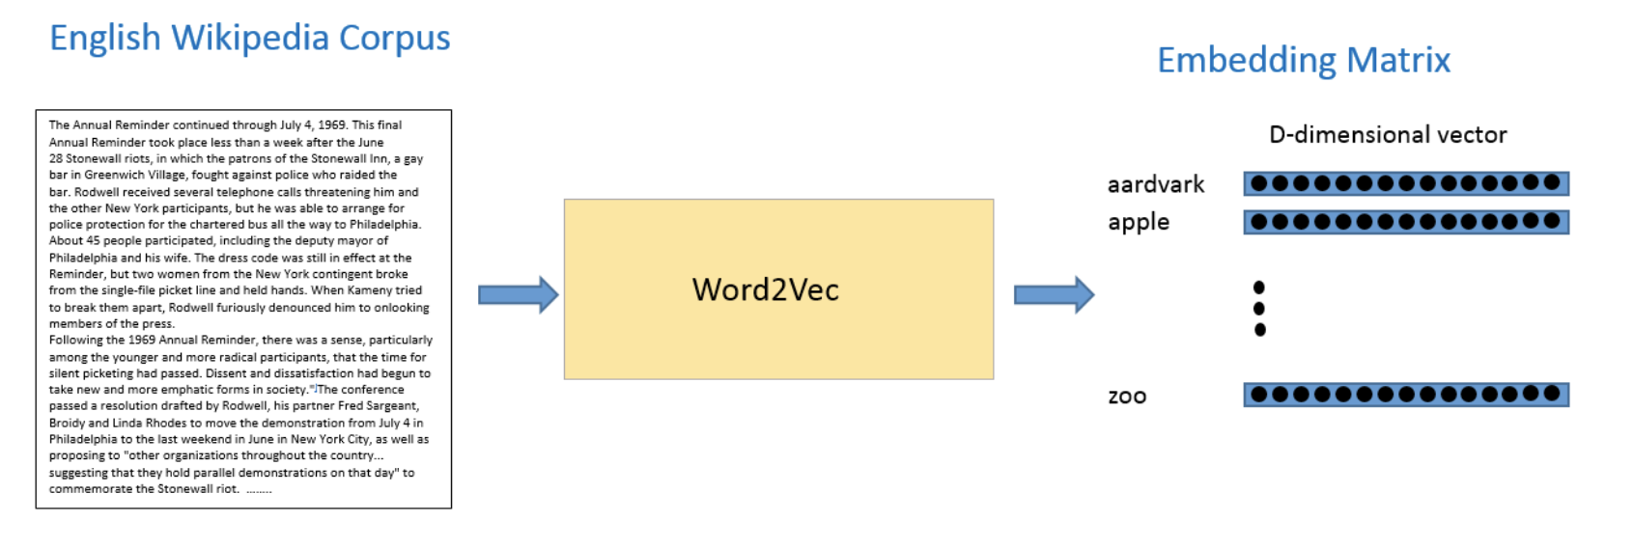
NLP...Tensorflow

Slide 6
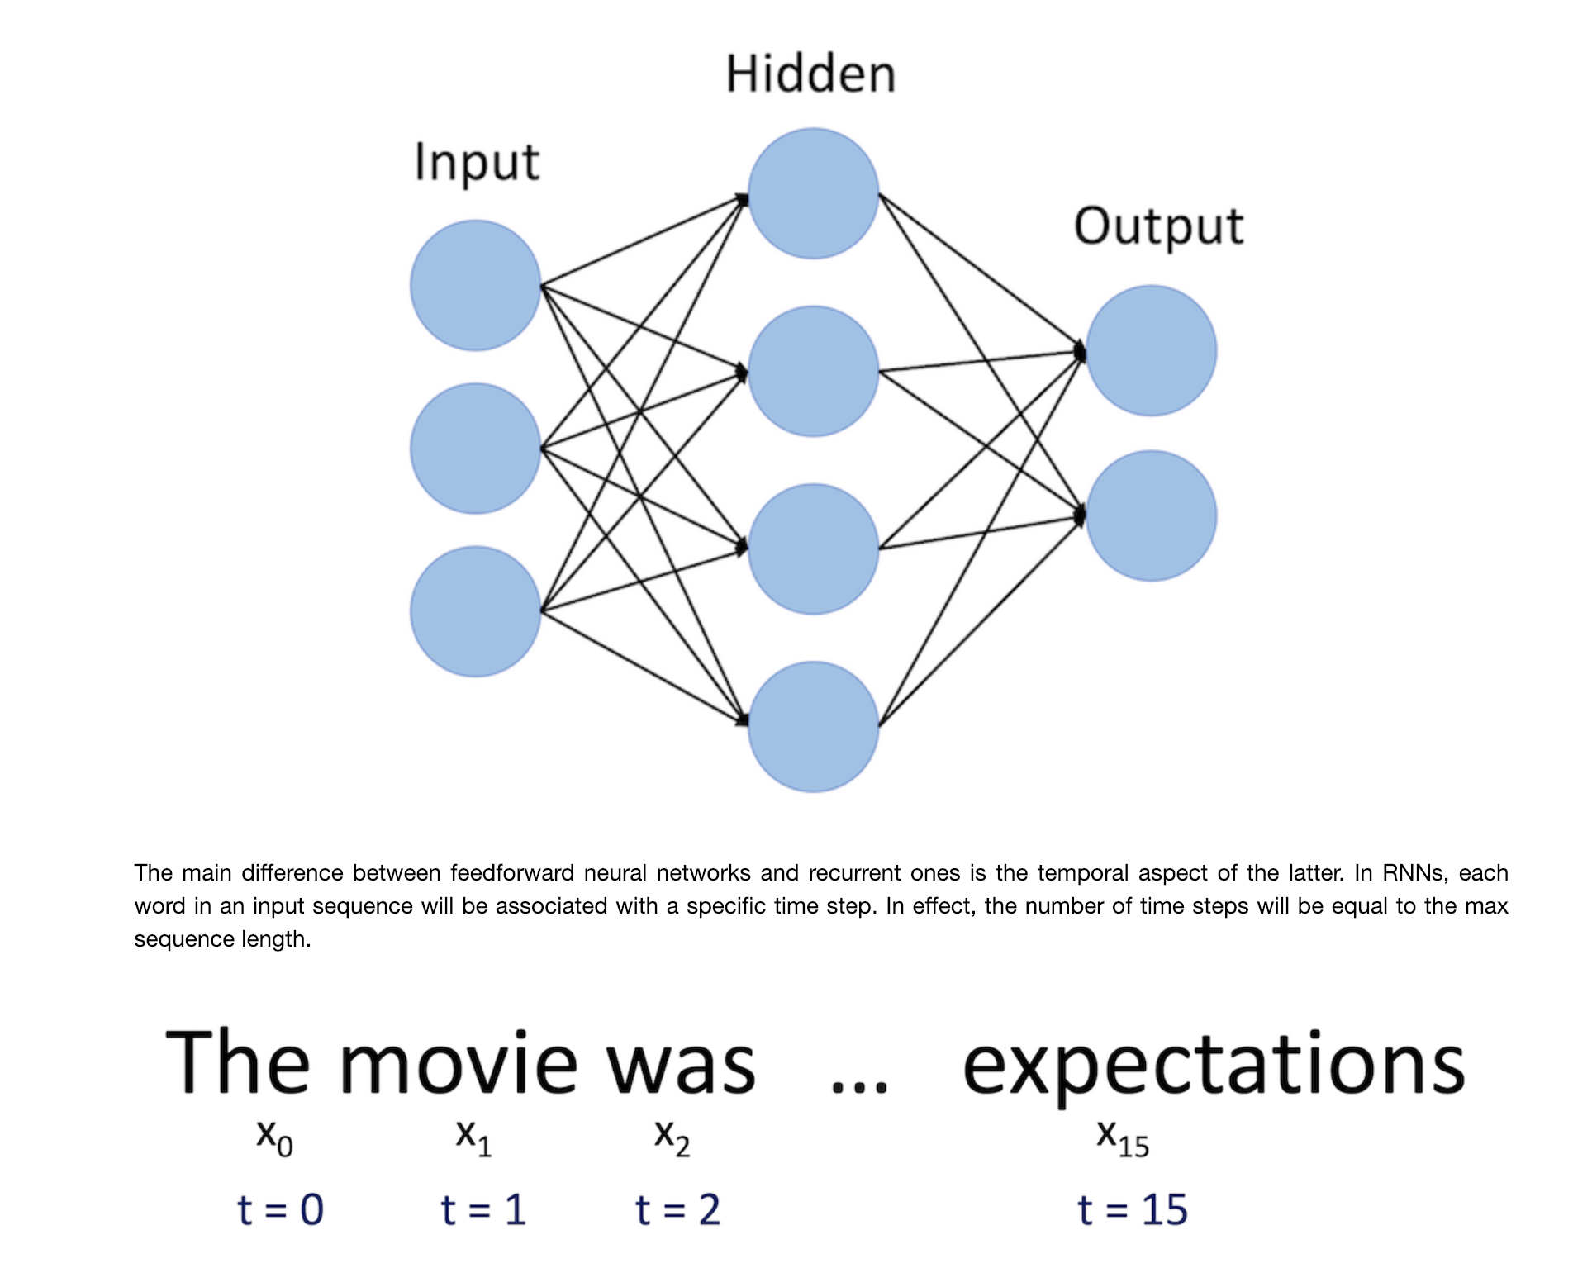
Recursive neural network

Slide 7
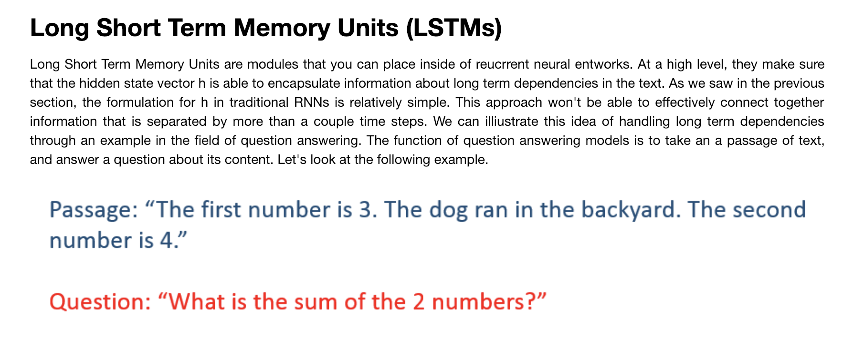
LSTM

Slide 8
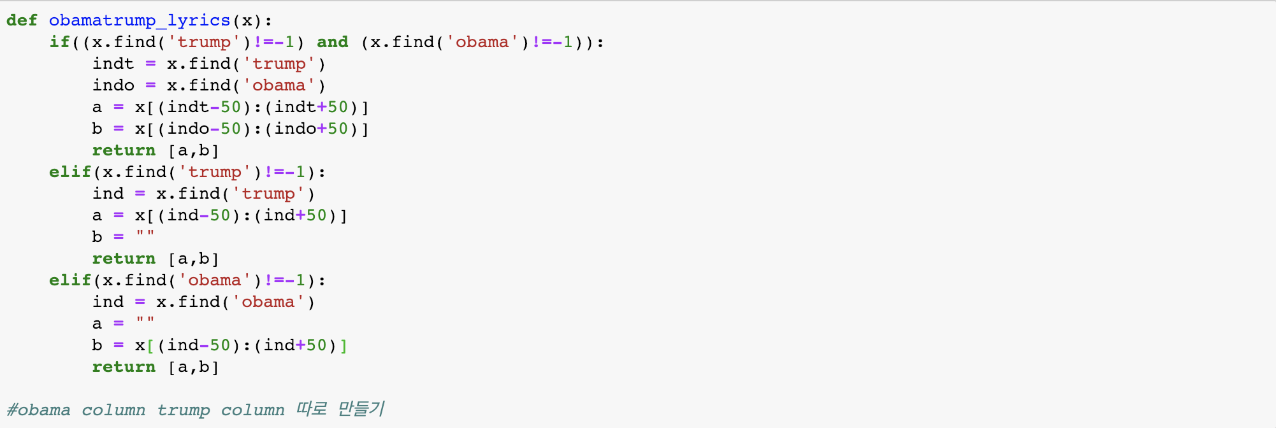
How I dealt with ”not sentence issue”

Slide 9
Shortcoming of NLP

